Slide 1

2025 Research Rewind
Promo Insights for 2026 Planning
Kelly Peterson
Date: Oct 2025

Slide 2
Who are “Deal Seekers” anyway?
Source

Slide 3



3 Personas were identified
Deal Hunters
I want to make sure I’m getting the best possible deal on every order I place.
Budget Minders
I need quality food within my cost range, a promo is helpful but not the only way to save
Thrill Seekers
I am going to order what I want regardless of promotions, but it is exciting when I get a good deal

Slide 4

BM are most focused on keeping under a budget threshold while TS and DH are more focused on the amount of savings
Financial goals when ordering (%T2B agree with statement)
Deal
Hunters
Budget Minders
Thrill
Seekers
Keeping my total spend under a threshold I feel comfortable with | 33% | 45% | 35%
Getting a good deal for my order | 40% | 43% | 46%
Making sure I am spending the least amount possible across ordering options | 28% | 12% | 19%
Base: n= 126 Deal Hunters, n=60 Budget Minders, N=85 Thrill Seekers

Slide 5
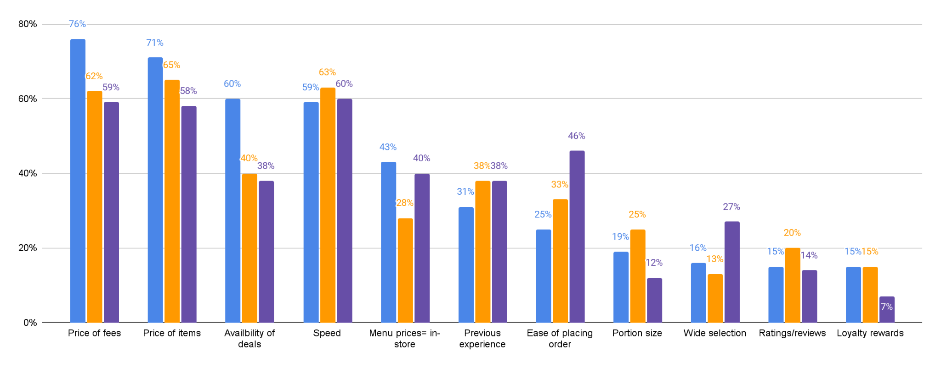
Speed, ease of placing order & selection are all important to TS
Most important factors when selecting where to order
Deal Hunters
Budget Minders
Thrill Seekers
Base: n= 126 Deal Hunters, n=60 Budget Minders, N=85 Thrill Seekers

Slide 6
BM and TS put a greater importance on food timeliness quality and convenience while DH focus more heavily on the deal.
 | Deal Hunters | Budget Minders | Thrill Seekers
Promos are a must:
I will not place an order on any app unless there is a promotion or discount code I can use | 54% | 7% | 2%
I feel guilty when I place an order without a promotion because of the extra costs for delivery | 90% | 12% | 41%
I like to shop around for the best deal and that includes when ordering takeout | 94% | 15% | 64%
Deal seeking is emotional:
I generally am not price sensitive, but like the feeling of getting a good deal | 31% | 17% | 79%
I enjoy the thrill of finding a good deal | 91% | 33% | 75%
Deals are not the #1 priority:
The convenience of ordering on DoorDash is more important than the amount that I spend | 11% | 27% | 52%
I care more about food prices and fees than about getting promotions and discounts | 51% | 53% | 62%
I care more about speed and food quality than promotions when placing an order on DoorDash | 29% | 40% | 55%
Base: n= 126 Deal Hunters, n=60 Budget Minders, N=85 Thrill Seekers

Slide 7
DH are younger in cities, BM are skew single and TS skew the oldest and in more town or rural communities.
 | Deal Hunters | Budget Minders | Thrill Seekers
Age:
18 to 34 | 47% | 33% | 40%
35 to 49 | 36% | 42% | 26%
50+ | 10% | 18% | 24%
Marital Status:
Married/Partnered | 43% | 35% | 44%
Single | 39% | 47% | 37%
Divorced | 8% | 7% | 6%
Education:
High school diploma or GED | 16% | 23% | 17%
Some college, but no degree or associate's degree | 25% | 31% | 30%
Bachelor’s degree + | 52% | 45% | 44%
Area:
Major metropolitan city | 20% | 13% | 13%
City | 33% | 28% | 26%
Suburb | 29% | 37% | 34%
Town | 8% | 12% | 14%
Rural area/ Countryside | 2% | 3% | 6%
Base: n= 126 Deal Hunters, n=60 Budget Minders, N=85 Thrill Seekers

Slide 8
Persona cheat sheet:
Price sensitivity | Promo usage | Promo emotions | Frequency of order | # of ppl typical ordering for | Preferred promo type
Medium | Almost every order | Must-have | 1-2 times per month | 1 | No minimum & BOGO
High | Rarely | Functional | Weekly | 2+ | % off or Free item
Low | Every few orders | Exciting | Weekly or more often | 2+ | Free item, BOGO, loyalty
Deal Hunters
Budget Minders
Thrill Seekers

Slide 9
How do Cx find deals on DoorDash today?
Source

Slide 10
We must think about the context; Cx either visit Doordash planning to select their Mx based on the deals available…..
“
I try to look for deals, say things that are discounted, even if it's just 15, 20 percent. Or even the $5 off of like the 15 or 20, something like that.
”

Slide 11
…OR they are Cx who have a cuisine or dish in mind but want to find a deal
“
I typically order from places I already know. So ones I know that are close so that my food doesn't get cold. Ones I know we like, ones I know that I do have a lot of issues
”

Slide 12
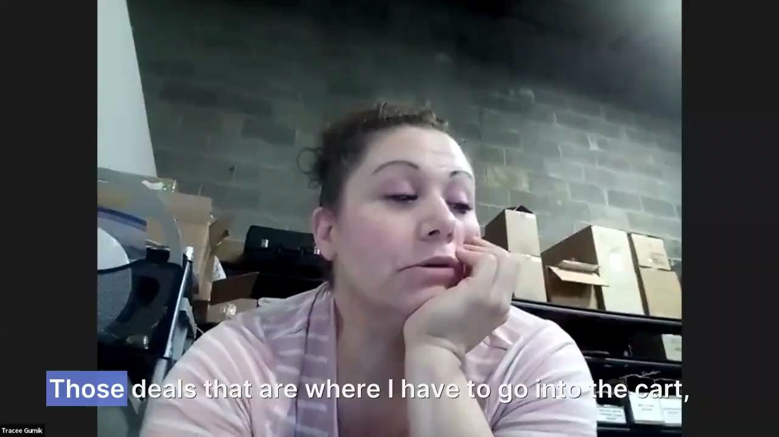
Today, deal discovery happens a lot later than we think…
Almost all of the Cx we spoke to said they most often learn about deals in the cart. They sometimes like at badges or carousels on the homepage but are not able to get the full picture of a deal there.

Slide 13
Today pill filters are not that helpful, and a little confusing
All of the Cx that we spoke with had used a pill filter at least once to narrow down their options. A few of the Cx we spoke to did not realize that you could select more than one pill at a time to narrow down results.
Cx had used the following pills:
Deals
Under 30 mins
DashPass
“
Once I go to search and click deals, like the amount of poke places is so much and there's like so many different kinds of deals, and then I'll just kind of get lost in here.
”

Slide 14
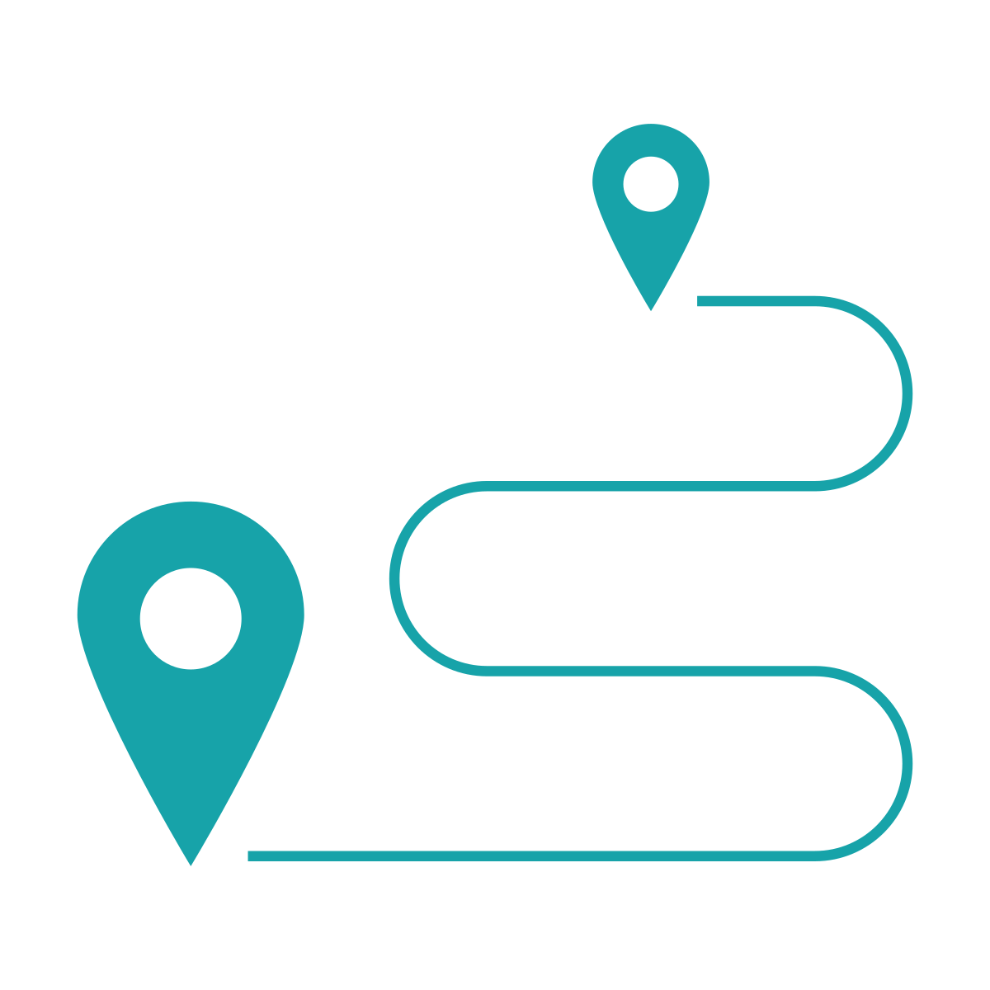




Discovery experiences should clearly address the top Mx selection criteria of deal seeking Cx
The highest savings available to me
The distance of the Rx/time until delivery
The cuisine type
The images
The restaurant quality
*Note these criteria are consistent with research around discovery and Mx selection

Slide 15
What about when Cx compare promos between DoorDash accounts?
Source

Slide 16
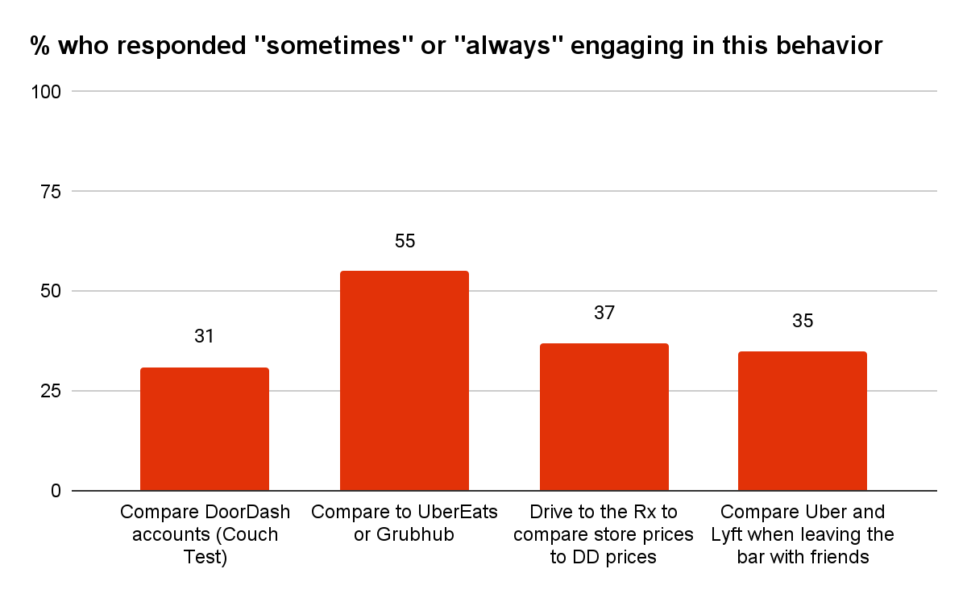
In the survey, 31% of Cx reported that they “sometimes” or “always” compare their DoorDash order to the same order on a different DoorDash account, which seemed high

Slide 17
Since that seemed a little high, we made some changes to the survey to really pressure test that 31%
We…
✅looked at the percentage of Cx who said that they “always” couch tested
… that was 8%
🔄reformatted the couch test question to make it harder to click through the answers (“straightlining”)
… still ~30%
⛔added a question where the answer should be “never,” to get a sense of a “false positive rate” for the entire survey. (“Drive to the restaurant you are considering and compare the prices on their menu to the prices on DoorDash.”)
… the result was 37%,
so we might indeed have a lot of false positives
🥸and then a few Cx who said in the survey that they were couch testers, when interviewed it turned out
… that they weren’t actually couch testers
So if we want to be conservative, we would say that the incidence of Cx couch testing is somewhere between 0% and 31%, and most likely something like 10-20%.

Slide 18
Couch testers differ from non-couch testers in ways that make sense
Compared to non-couch testers, couch testers are statistically significantly more likely to:
◀️
💰
💃
💸
Order less than 1x per week
Say that promo availability, portion size, and no menu inflation are important ordering considerations
Be Classic Cx, not DashPass Cx
Be price sensitive

Slide 19
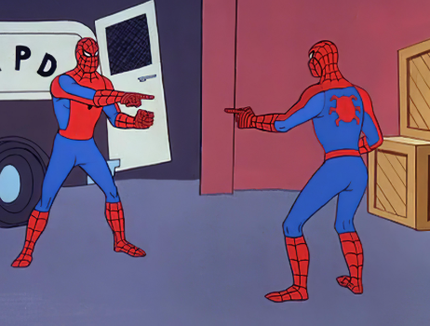
Of couch testers, 41% are actually comparing to another account that they themselves own…
We know that many Cx have multiple accounts under their own name.
For instance, in James’ recent DashPass Paused Account research, he found that 54% of Paused DashPass Cx have multiple accounts – an average of 6.6 accounts each (!)
We also know from Vero’s 2023 research on account switching that one of the primary reasons Cx have multiple accounts is for “promo hacking” – they know that different accounts get different kinds of promos and maintain multiple accounts to maximize their likelihood of getting a good promo.
The Growth team is apparently building a “switcher button” that will make it easier to switch accounts at login 😬

Slide 20
…and 59% are comparing to another person’s account
Of the 59% comparing to another person’s account, that other person is
👰‍♀️36% partner or spouse
👫34% friend
🧑‍💼14% coworker
👵11% other, usually a family member like mom, sister, etc
🏡5% roommate

Slide 21
Key Insights
🍐
THERE IS MORE COMPARISON – AND DIFFERENT KINDS OF COMPARISON – THAN WE EXPECTED
We conservatively estimate that 10-20% of Cx engage in couch testing.
Of couch testers, 41% are actually comparing to another account they themselves own. 59% are comparing to another person’s account, usually a family member or friend.
CX DON’T SET OUT TO COMPARE, BUT WILL KEEP COMPARING WHEN DIFFERENCES ARE NOTED
The most common scenario is two Cx in the same space, planning to order food to eat together, both browsing Rx menus from their own phone/account to decide on what to order, and then incidentally discovering that they have different pricing/fees or are offered different promos.
Cx who have noticed differences in the past are more likely to couch test in the future, but still just order from whichever account is cheapest.
COUCH TESTERS HAVE NO BAD FEELINGS ABOUT DIFFERENT PROMOS FOR DIFFERENT ACCOUNTS
Cx understand that there might be variance between accounts in promo availability, but feel like they still have access to the better promo on the other account since they have a relationship with the other person.
Most Cx don’t think about Mx-funded and DD-funded promos differently, but if they do, they would expect Mx-funded promos to be the same for all Cx and would want to understand why any differences exist.
👯
🤷‍♀️

Slide 22
What about when Cx compare promos between other platforms?
Source

Slide 23
While most Cx state that they compare cost across apps…
64%
59%
62%
of Occasional Cx state that they compare prices across apps
of DashPass Cx state that they compare prices across apps
Of Classic Active Cx state they compare prices across apps
Base: n=443 DoorDash users
Source: Comparing Across Apps

Slide 24
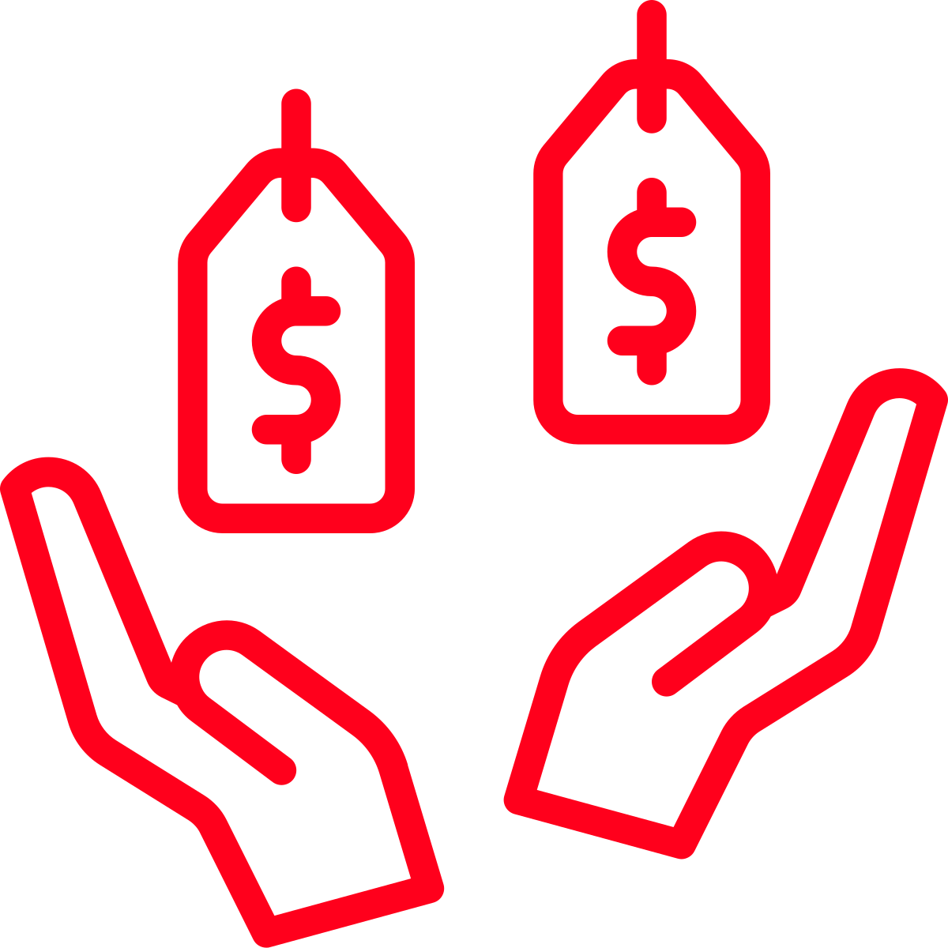
… their definition of comparison is not consistent
What does a comparison mean to Cx?
Most frequent
I have thought about what and where I want to order from before I go to any app to order
I go to place an order but high costs cause me to look at other apps
I open an app with the intention of comparing multiple apps
Least frequent
Base: n=443 DoorDash users
Source: Comparing Across Apps

Slide 25


Start
Have I seen any promos recently
Do I have a specific Rx I want to order from?
No
Yes
Most common comparison journey among value seekers
Is it available across multiple apps?
Yes
No
No
Yes
Order from available app
Search for discounts/promos; are they available on good selection?
Yes
No
Order from app with best discount
Build a cart and order from app with lowest price
Source: Comparing Across Apps

Slide 26


Quality and experience considerations only come into play when prices are similar across apps
Factors for selecting the best discount:
Selection where offer is available
Amount of offer (maximum/free meal)
Ability to stack/apply multiple offers
Minimum requirement for offer
Factors when price is similar
Past experience/quality with app
Menu item availability/ability to customize order
Delivery time
Loyalty programs
Base: n=443 DoorDash users
Source: Comparing Across Apps

Slide 27

Let’s have a Cx walk us through…
Source: Comparing Across Apps

Slide 28


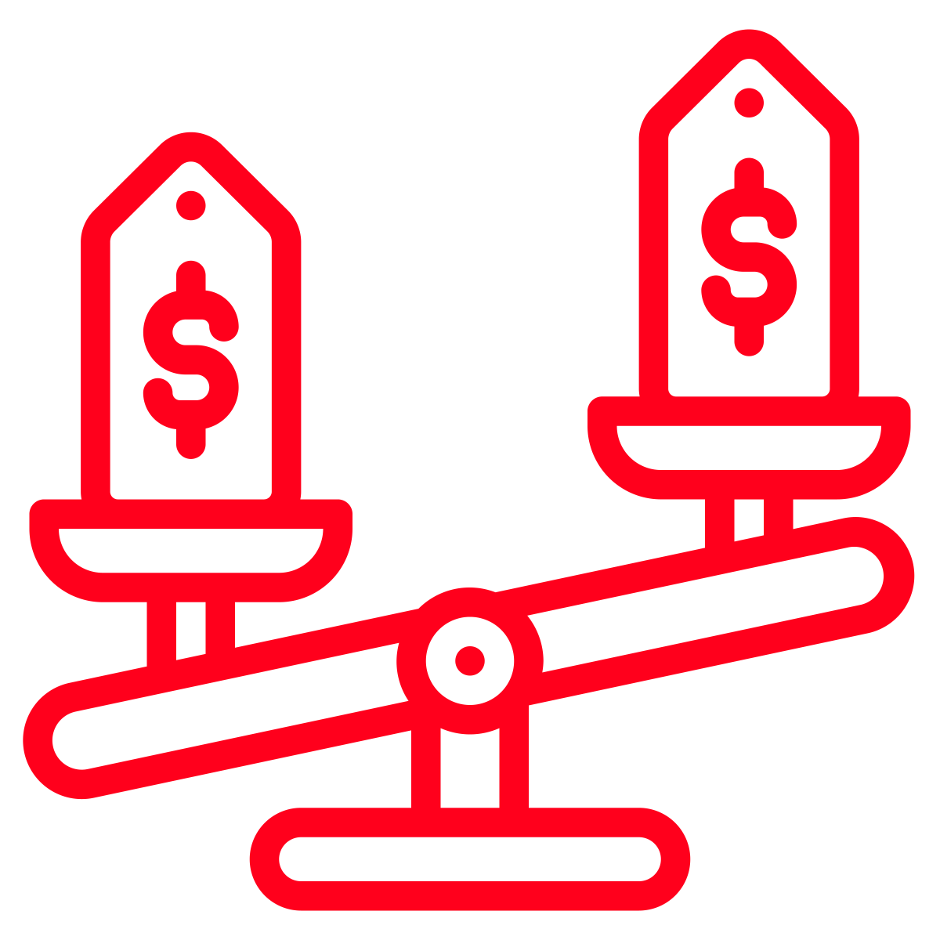

Summary of comparison experience
While Cx are most likely to get information for comparison on app, mental comparisons happen before they even open the app. Mental comparisons consider selection available and promotions received.
When Cx do not have a specific Rx in mind availability of discounts and promotions is often used to help make a decision. Whichever app has the greatest value promotion will win. Value is determined by cost savings and minimum requirements.
When Cx do not have discounts available and a Rx is on multiple apps they will build a cart with the same tip amount to compare prices. Whichever has the lowest cart price wins.
In situations where cart prices are the same or the difference is less than a dollar delivery quality, past experiences and loyalty are considered. For some Cx which app was opened last will be used to place the order.
Source: Comparing Across Apps

Slide 29
What about personalization?
Source

Slide 30

RELEVANT PROMOS & DEALS
💡What jumps out
Relevant Promos & Deals: Helps me find deals and promos that matter to me.
Cx who say Promos & Deals is more important (n=374) in Stated Importance are more likely to be:
  Lower income (<$50k)
Cx who say Promos & Deals is less important (n=184) are more likely to be:
  Older, Retired
  Women
  Married
  Less likely to have children/other mouths to feed
What matters more to Cx who care less about Promos & Deals is:
  Control Over My Experience
  Fast Options
  New Restaurant & Cuisine Discovery
  Quick Reorder
While Promos & Deals has more general appeal across segments in MaxDiff, a more nuanced picture emerges among Cx who value it less in Stated Importance.
⚡So what?
Relevant Promos & Deals can be a universal lever since they have general appeal across segments.
However, we could tailor the experience for the “less promo-driven” segment by more heavily prioritizing convenience, control, and discovery.

Slide 31
Thank you!

